Slide 1
Foreign language
in the field of 09.03.01 Informatics and Computational Technology
Educational Program (Track): “Web Technologies”
Foreign language
Embedded systems
Student: Alexander Romanov, group 241-321
Instructor: Elizabeth Kolodina
2025

Slide 2
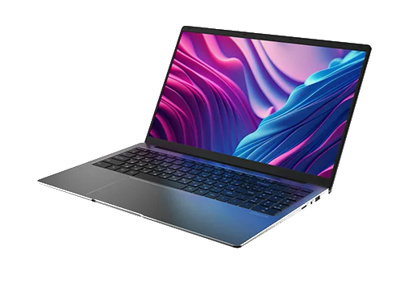
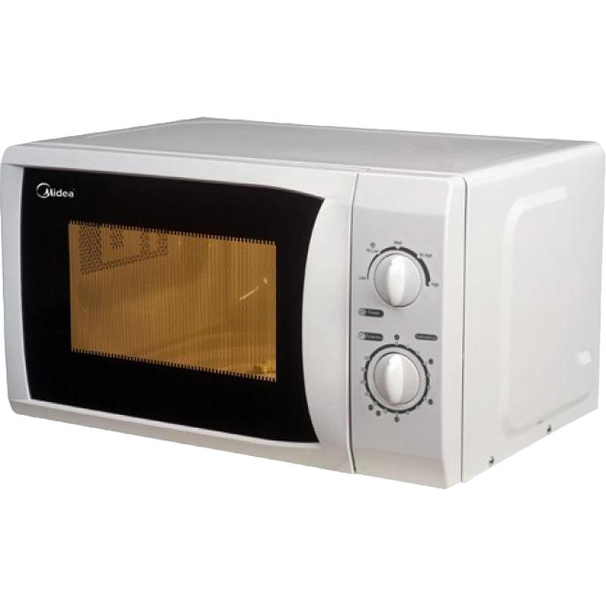
What are Embedded systems?
The Invisible Brains of Our Everyday Tech
NOT your laptop
BUT inside your microwave
Alexander Romanov, group 241-321
Your advertisement could be here

Slide 3
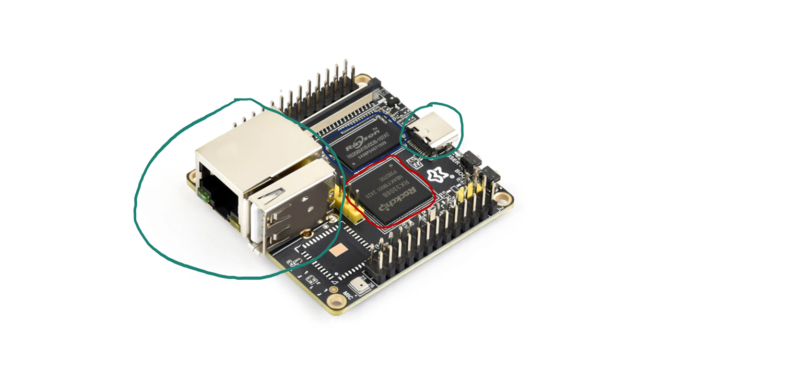
What is inside?
Every embedded system has 3 core parts:
Processor
Memory
I/O (input/output) Peripherals
Alexander Romanov, group 241-321
Your advertisement could be here

Slide 4
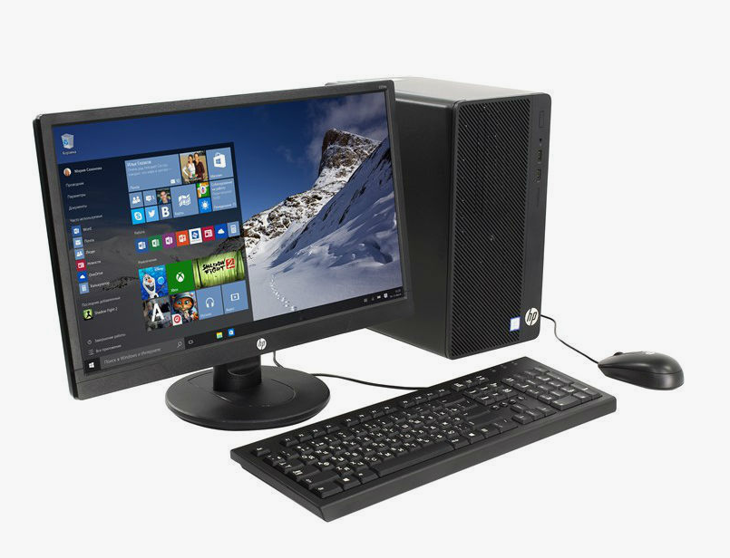
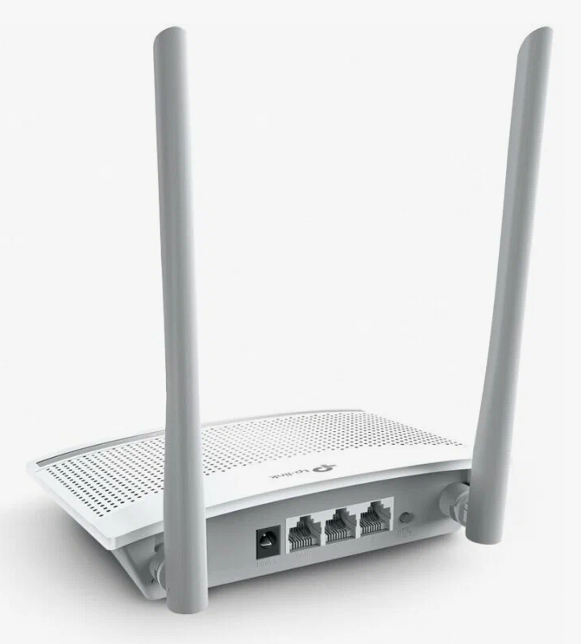
Key Features
Limited resources:
low power
small memory
cheap hardware
Real-time operation:
If an elevator detects a free fall, it must engage brakes instantly.
Reliability > Flexibility:
Runs for years without reboot
«I am rebooted daily. And you?»
«Never…»
Alexander Romanov, group 241-321
Your advertisement could be here

Slide 5
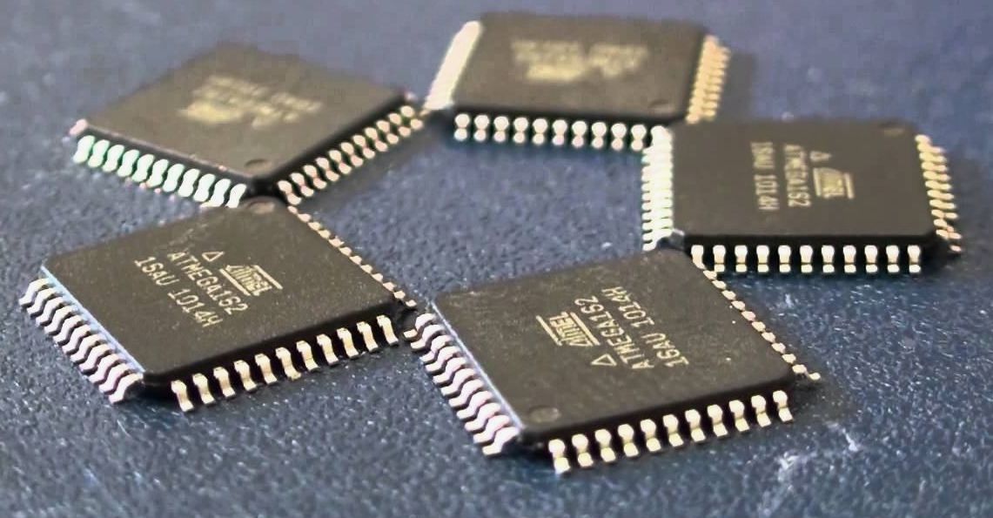
Mind-Blowing Stat
In 2009, 98% of all microprocessors made worldwide went into embedded systems - not laptops, phones, or servers.
Alexander Romanov, group 241-321
Your advertisement could be here

Slide 6
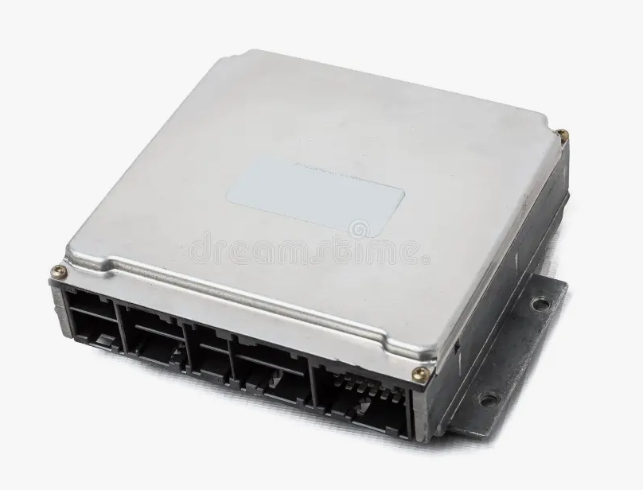
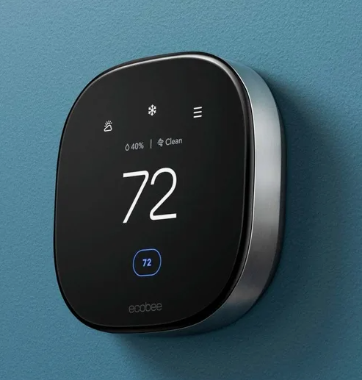
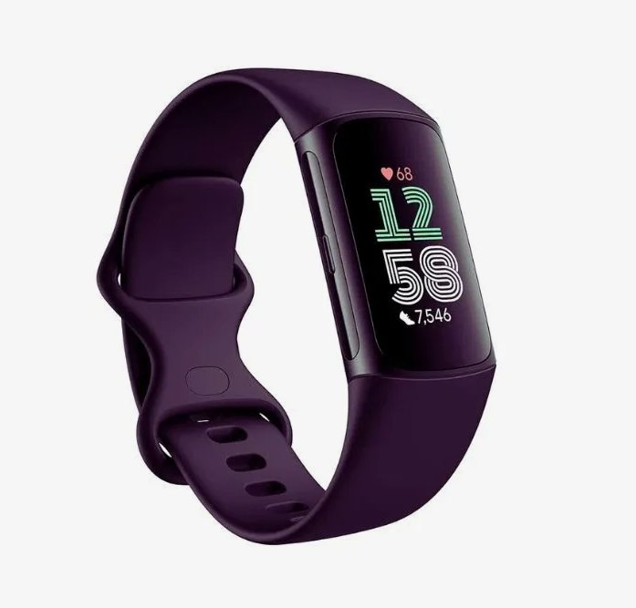
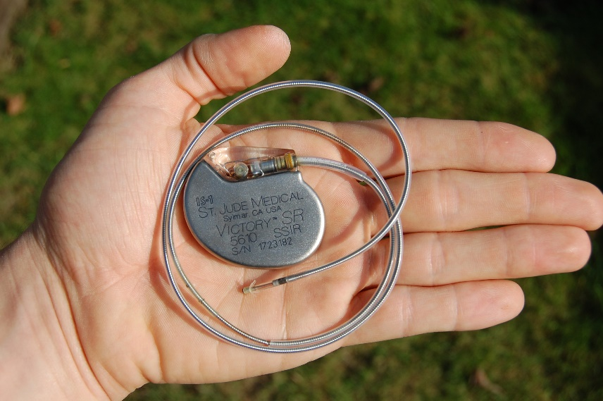
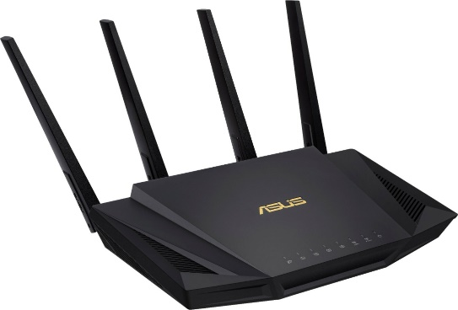
Real-World Examples
Car engine control unit
Smart thermostat
Fitness Tracker
Wi-Fi Router
Pacemaker
Alexander Romanov, group 241-321
Your advertisement could be here

Slide 7
Final Thoughts
Embedded systems are the silent workforce of the modern world.
They’re everywhere. And they just work.
Alexander Romanov, group 241-321
Your advertisement could be here

Slide 8
Thanks for your attention!
Foreign language
Embedded systems
Student: Alexander Romanov, группа 241-321
Instructor: Elizabeth Kolodina
2025

